Slide 1

ENHANCING NEUROLOGICAL DISEASE DIAGNOSIS WITH ErrP INNOVATIONS
GUIDED BY:
Ms.Praseeda B Nair
Asst.Professor
Dept.of ECE,AJCE
TEAM MEMBERS:
Little Therese Mathew,AJC20EC046
N Sreedu Krishna,AJC20EC054
Sheryl Varghese,AJC20EC065

Slide 2


Contents
Objectives | Conclusion
Literature Review | References
Block Diagram
Flow Chart
Result

Slide 3
OBJECTIVES
Investigate Error-related Potentials (ErrP) across different subjects, including individuals with schizophrenia, learning disabilities, and hyperactivity.
Compare ErrP signals between individuals with schizophrenia, hyperactivity, and healthy controls.
Examine ErrP acquisition in subjects with learning disabilities and hyperactivity.
Understand neural mechanisms underlying error processing and cognitive control.

Slide 4
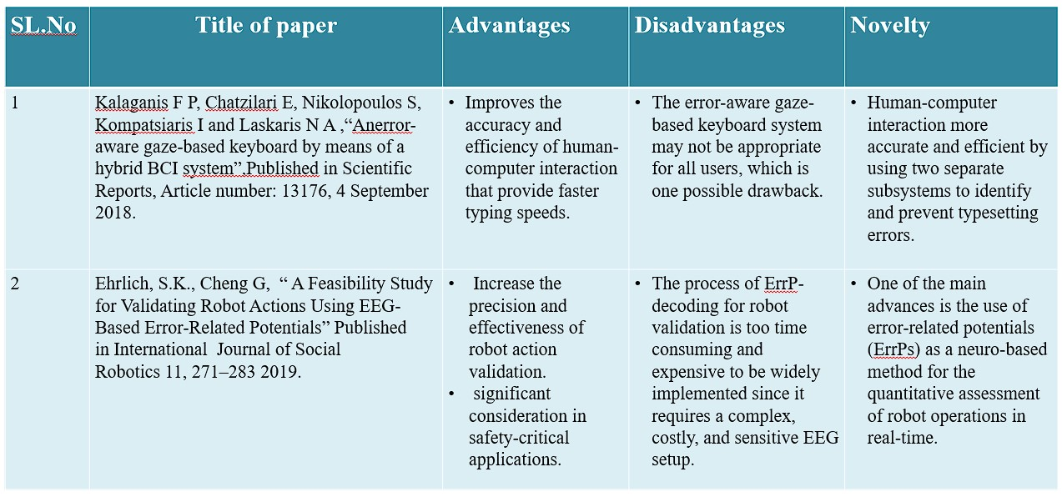
LITERATURE REVIEW

Slide 5
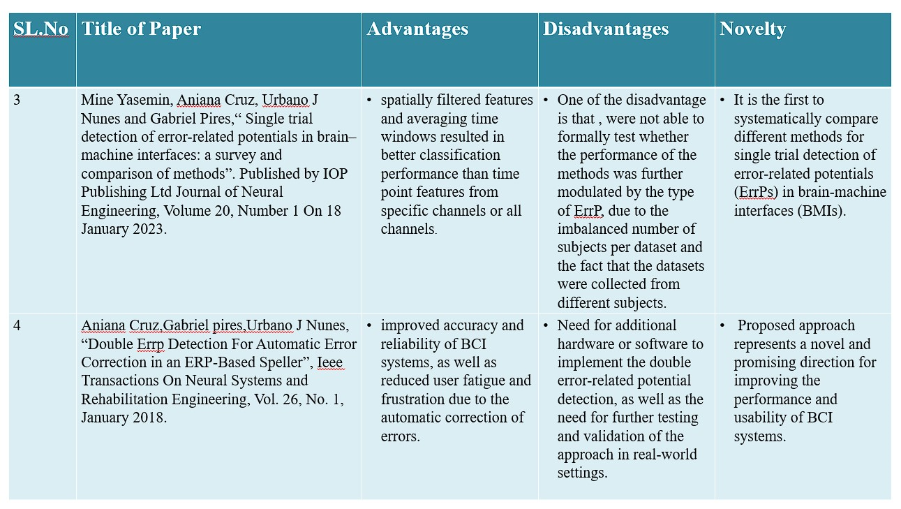

Slide 6
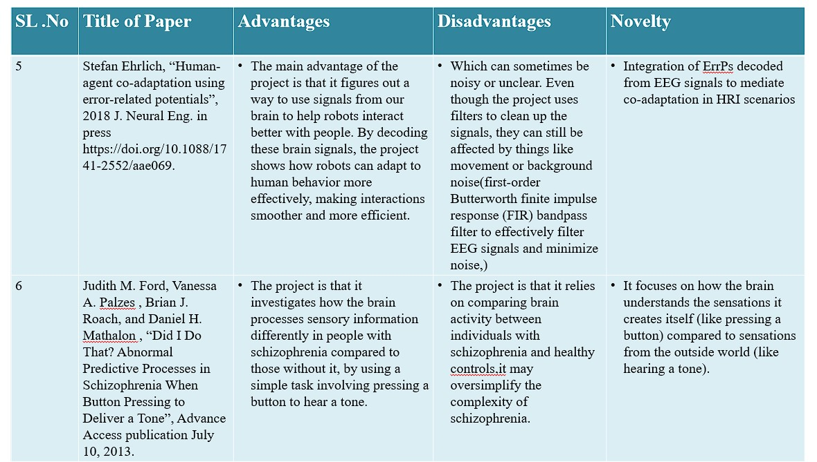

Slide 7
Electrode Placement
FLOW CHART
Data Acquisition
Data Preprocessing
Bayesian Smoothening
ErrP Extraction
Visualization
Analysis & Interpretation

Slide 8
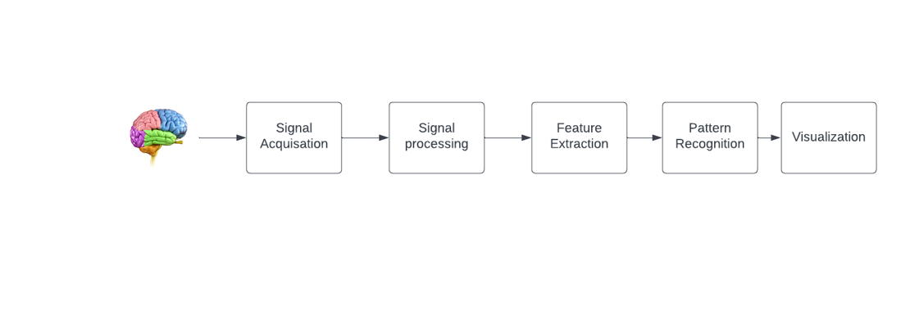
BLOCK DIAGRAM
Fig.1: Block Diagram

Slide 9
Signal Acquisition:
Place electrodes on specific areas of the scalp.
Gather EEG signals from the brain's frontal, central, and parietal lobes.
2.Signal Processing:
Refine the acquired signal by eliminating noise and inconsistencies.
Steps involved filtering and smoothening.
3.Feature Extraction:
Identify distinct characteristics (features) of the EEG signal.
4.Pattern Recognition:
Identify various pattern of Errp Signals from different subjects.
5.Visualization:
Present processed EEG signals visually for analysis and interpretation.
Graphical representation aids in understanding brain activity patterns.

Slide 10
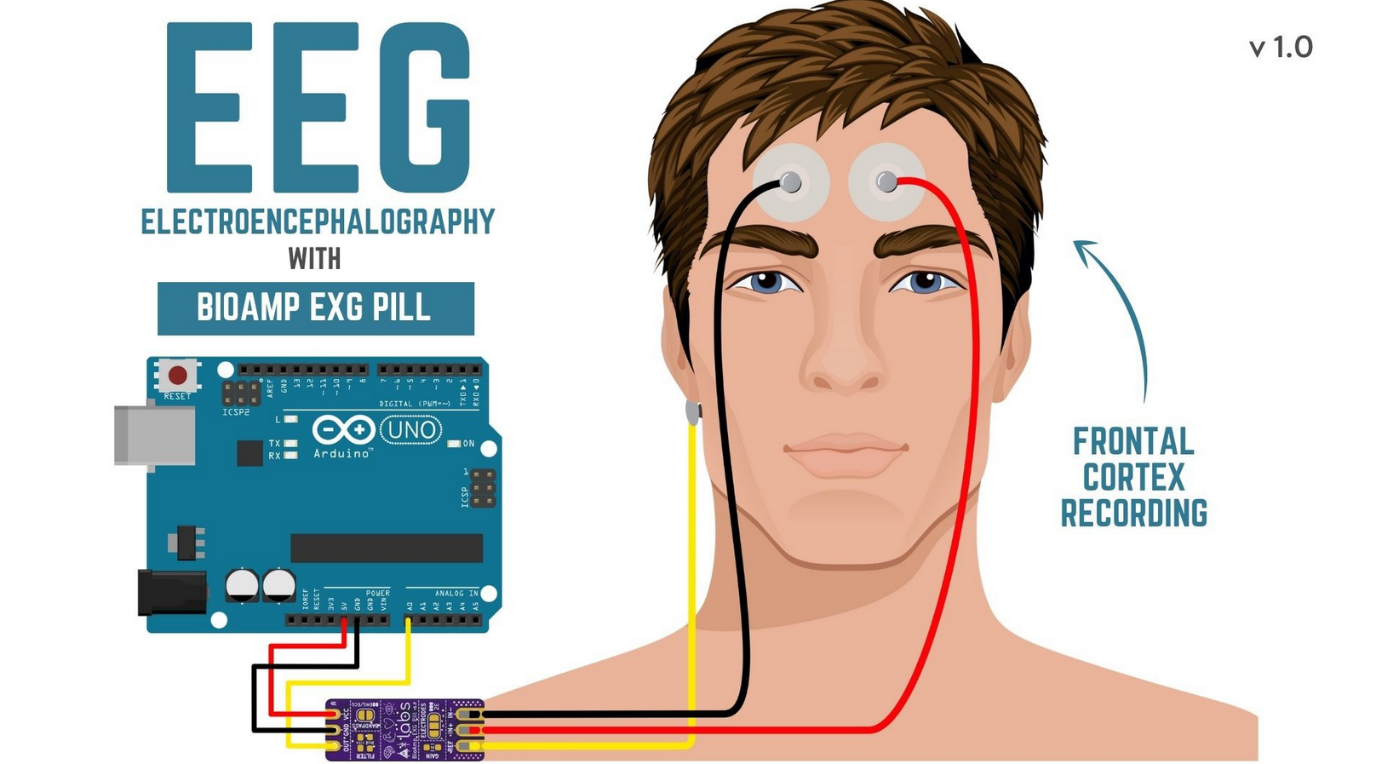
ELECTRODE PLACEMENT
Fig.2: Electrode placements to record EEG from the Pre-Frontal Cortex part of the brain

Slide 11
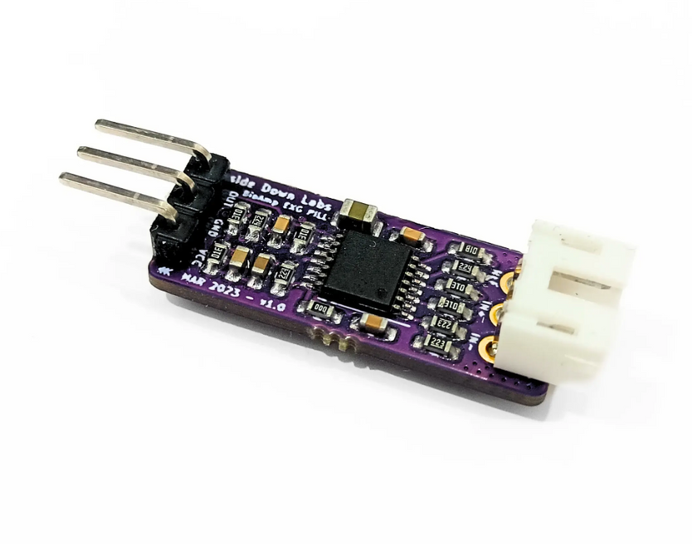
COMPONENTS USED
BIOAMPEXG PILL
BioAmp EXG Pill is one of a kind pill-size chip that can record publication-grade biopotential signals from your body be it from the heart (ECG), brain (EEG), eyes (EOG), and muscles (EMG).
It is used in projects of Human-Computer Interface (HCI) and Brain-Computer Interface (BCI) domains.
Fig.3: BioAmp EXG Pill

Slide 12
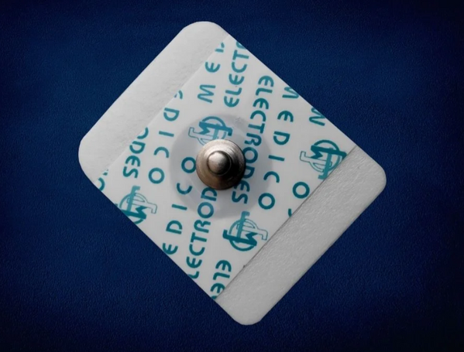
ELECTRODES
Material: Polyethylene foam & acrylic medical-grade adhesive
Gel Type: Conductive Solid Hydrogel
Snap Connector Material: Stainless Steel
Size: 4.0 x 3.3 x 0.1 cm
Ultra-low impedance (<100 ohms) promotes rapid baseline stabilization
Electrodes have lift tabs for easy placement and removal
Ag/AgCl adhesive solid gel requires minimal cleanup before applying the electrodes to the body.
Special gel formulation allows for providing the best possible interface between the body and Bioamp cable.
Fig.4: Electrode

Slide 13
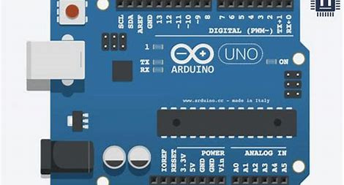
ARDUINO UNO
Digital (PRM-) pins: These pins can be used to input or output digital signals.
RX (Receive): This pin is used to receive serial data.
TX (Transmit): This pin is used to transmit serial data.
Analog In: These pins can be used to read analog voltage levels.
5V: This pin supplies 5 volts of power.
GND: This pin is the ground connection.
Fig.5: Arduino UNO

Slide 14
RESULTS
We Compared ErrP signals of healthy and unhealthy peoples.
Successfully detected Error-related Potentials (ErrPs) extracted from EEG signals using different methodologies.
Firstly by using MATLAB code we compared the ErrP of Healthy subjects by employing different task to them.
We used advanced signal processing techniques like:
Filtering: cleaned up the data to focus on relevant signals.
Analysis: studied the patterns and characteristics of the signals.
Feature extraction:picked out specific aspects of the signals for further investigation.
Preprocessing: prepared the data for analysis by removing noise.
Compared the signals between correct and error conditions.
Finally, plotted the error and corrected signals to visualize the differences.

Slide 15
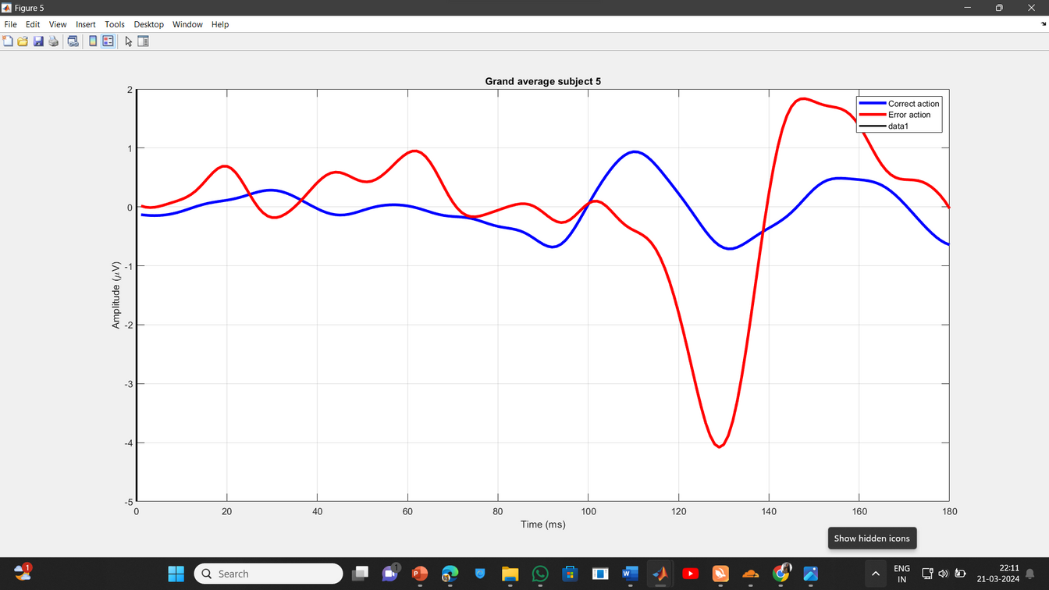
Fig.6: ErrP pattern Recognition by using Gaze based keyboard task.
The Fig.8 shows the average brain activity waveforms for correct and error trials during typing tasks, highlighting differences in neural responses.
Using an EBNeuro EEG device with 64 electrodes and an SMI myGaze eye-tracker, record the brain activity and gaze movements.

Slide 16
The graph overlays average brain activity waveforms for correct and error trials, revealing differences in neural responses.
Our main goal was to study the physiological reactions linked to error perception during typing tasks in healthy individuals.
This thorough approach enabled us to examine how the body responds to errors during typing, providing insights into how humans detect and correct mistakes.
Each session involves typing a sentence with pauses, collecting data on typing speed, accuracy, and error detection.

Slide 17
EEG ErrP Dataset Comparison between Schizophrenia and Healthy Controls
We acquired EEG datasets from individuals diagnosed with schizophrenia and healthy controls.
Using Python, we conducted analyses to compare EEG signals during a button-tone task between these two groups.
Our analysis involved preprocessing the EEG data to remove artifacts and ensure data quality.
We then plotted the EEG signals recorded during the task for both the schizophrenia and healthy control groups.
The graph depicting Error-related Potentials (ErrP) in individuals with schizophrenia reveals heightened negative suppression compared to healthy controls, indicating abnormal neural response patterns during error monitoring tasks.

Slide 18
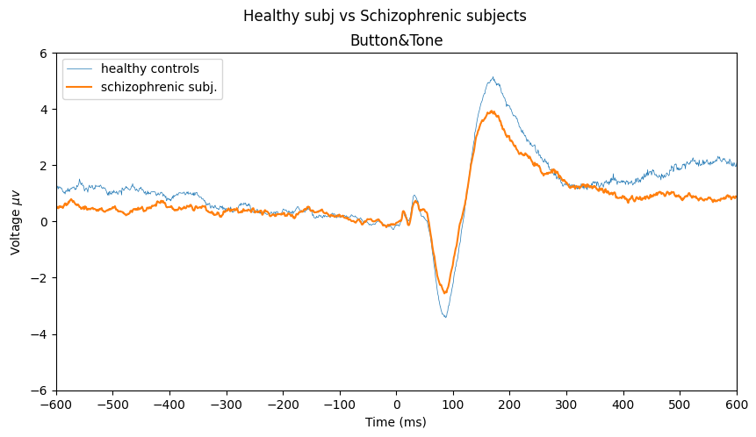
Fig.7: Dataset comparison between the HC and SZ

Slide 19
Error-related Potentials (ErrP) Acquisition in Subjects with Learning Disabilities and Hyper Activity
We captured real-time signals using a Digital Storage Oscilloscope (DSO) during a P300 Speller game.
The captured signals were then converted to CSV format for further analysis.
We applied Bayesian smoothing techniques to the CSV data to enhance signal clarity and reduce noise.
By focusing on the Error-related Potentials (ErrPs), we extracted and analyzed specific neural responses associated with errors in the P300 Speller game.
Finally, we plotted the ErrP graph to visualize and interpret the neural activity related to errors during the task.

Slide 20
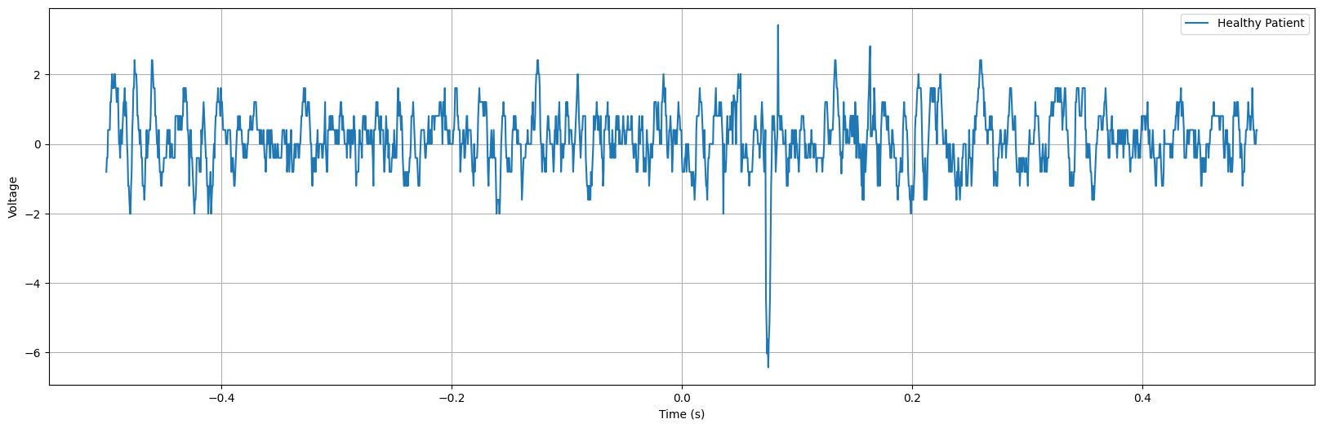
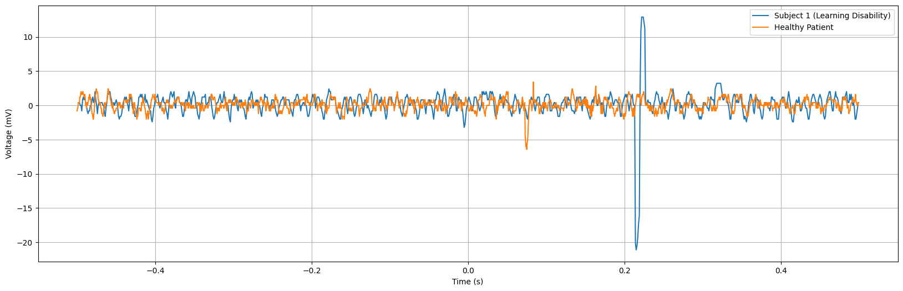
Fig.8: Healthy control
Fig.9: Subject 1

Slide 21
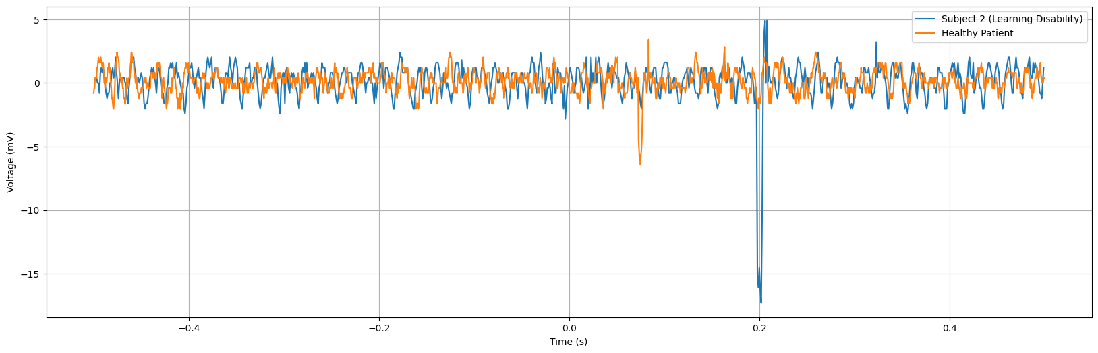
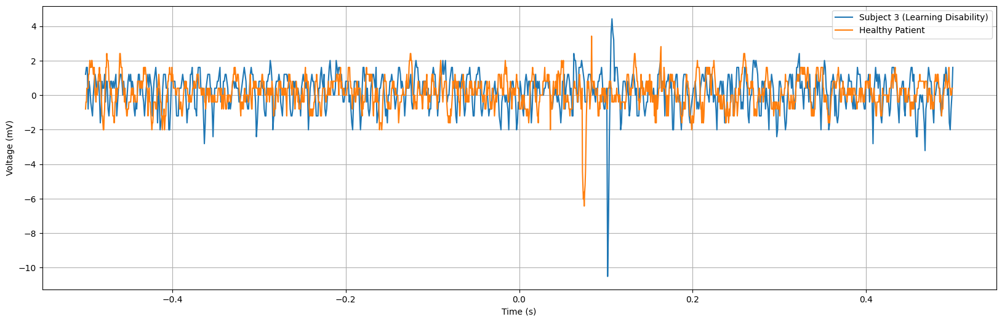
Fig.10: Subject 2
Fig.11: Subject 3

Slide 22
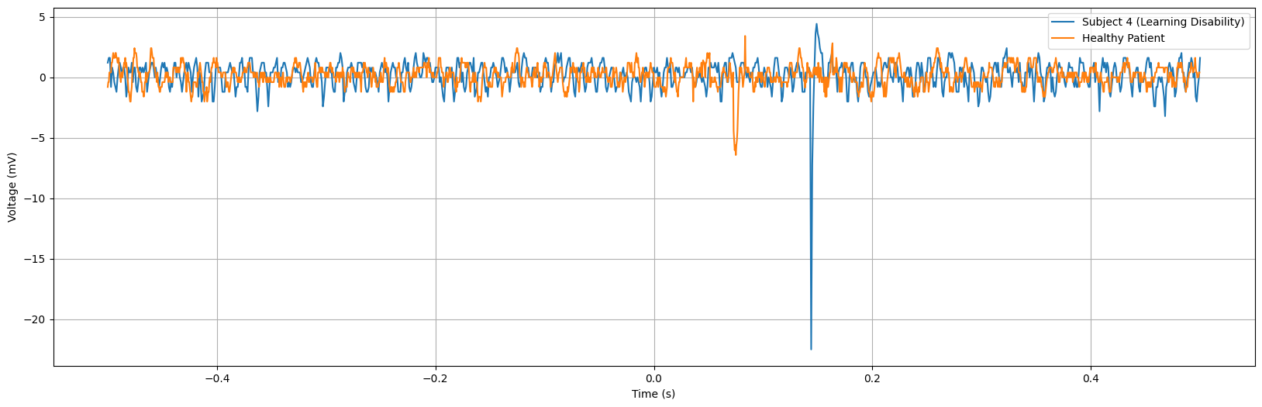
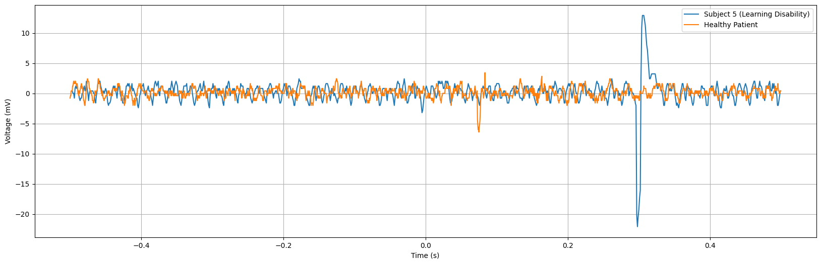
Fig.12: Subject 4
Fig.13: Subject 5

Slide 23
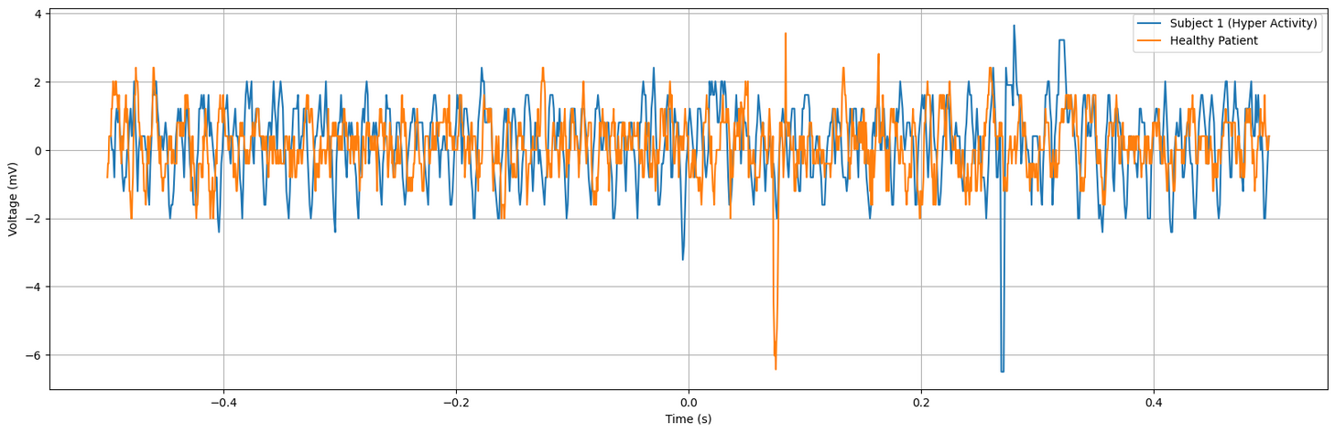
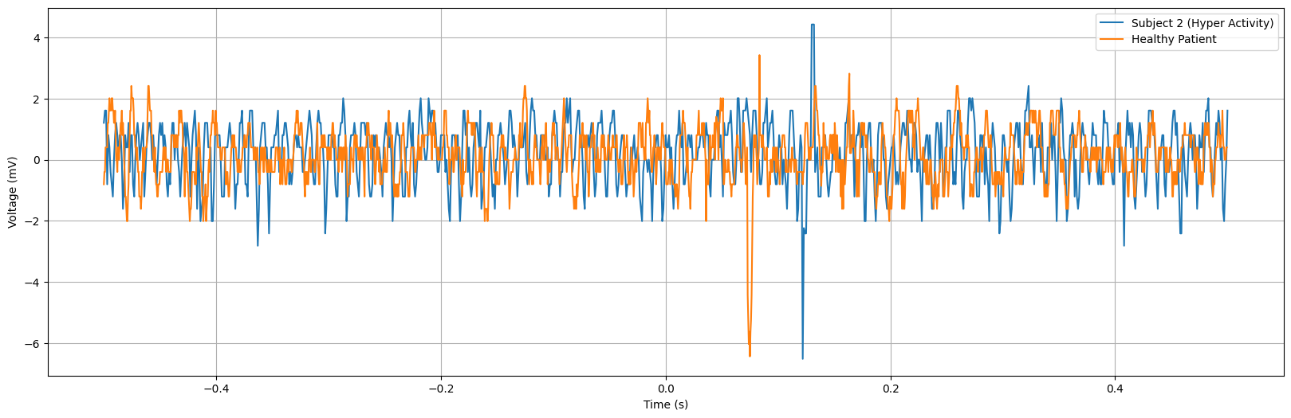
Hyper Activity
Fig.14: Subject 6
Fig.15: Subject 7

Slide 24
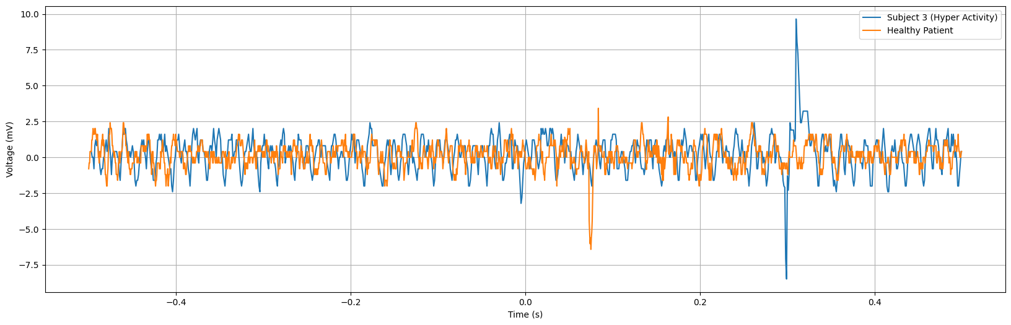
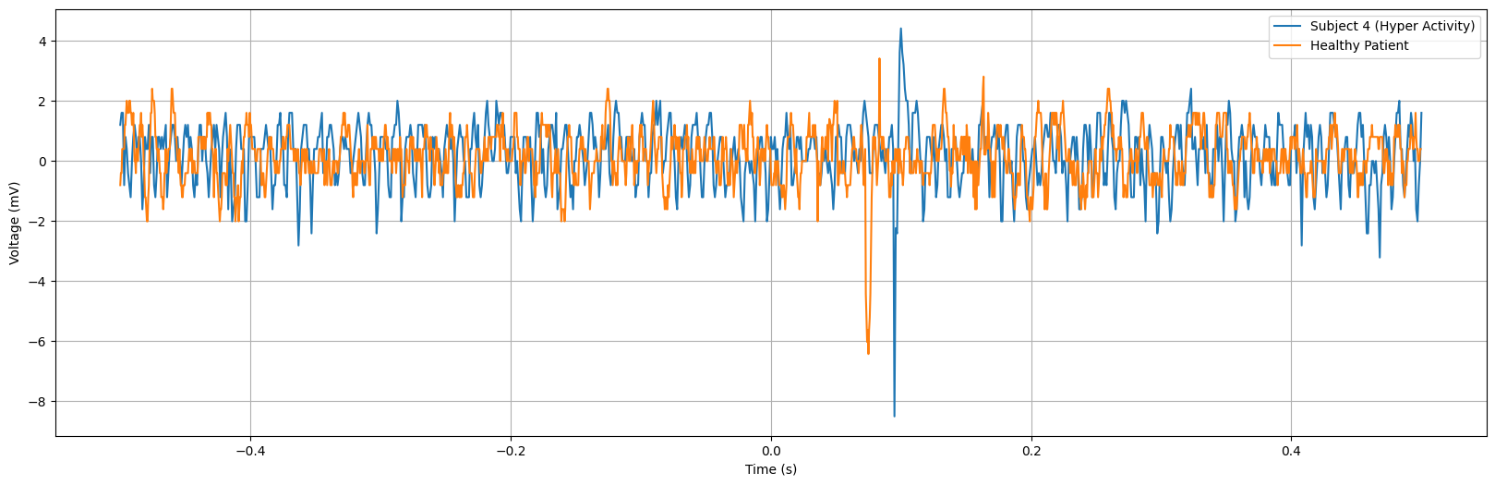
Fig.16: Subject 8
Fig.17: Subject 9

Slide 25
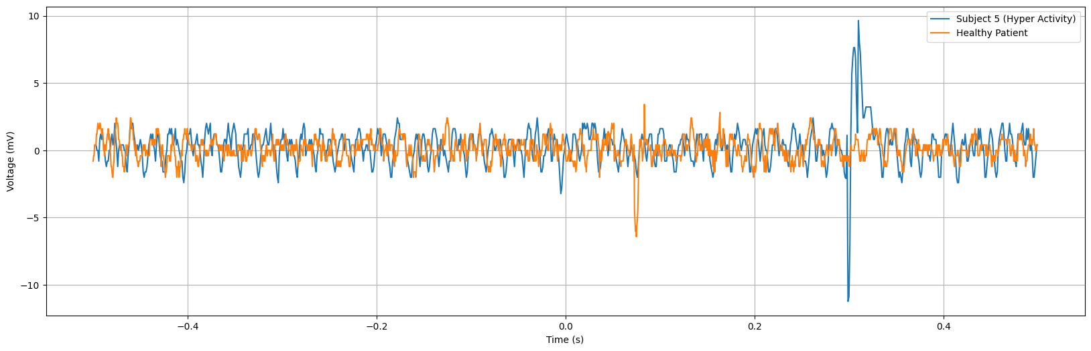
Fig.18: Subject 10
Based on the above graphs,Hyperactive subjects show lower amplitudes in the negative peak, possibly indicating altered neural processing or reduced sensitivity to error detection cues. This could stem from differences in cognitive functioning and attention between hyperactivity and learning disorders.

Slide 26
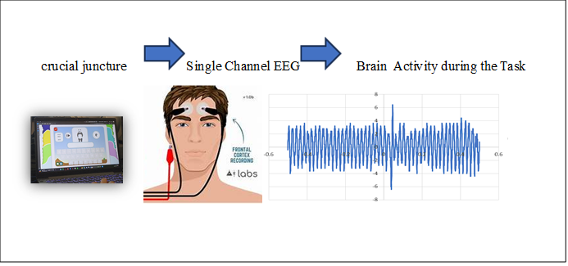
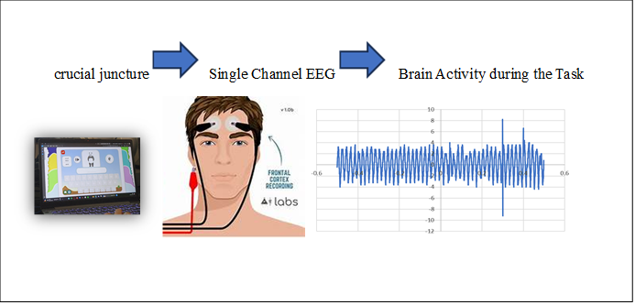
Fig.19: Healthy controls (Understanding Error Monitoring Mechanisms through EEG Analysis)
Fig.20: Learning Disability Patients(Understanding Error Monitoring Mechanisms through EEG Analysis)

Slide 27
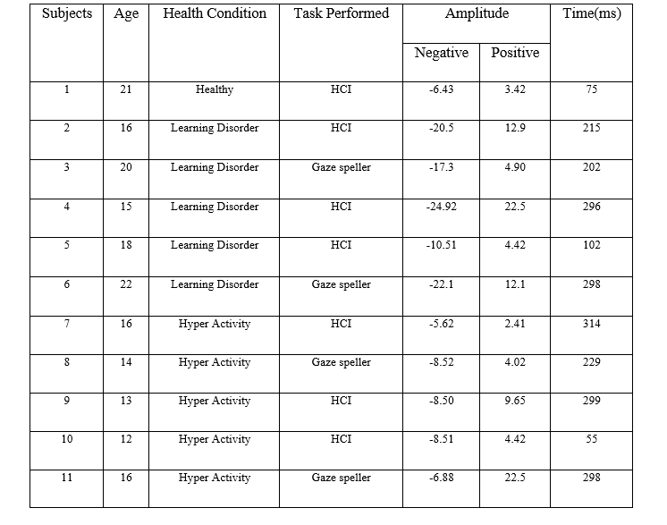
Table 1: ErrP Graph comparison

Slide 28
CONCLUSION
ErrP investigation reveals insights into error detection and cognitive control across various contexts.
Schizophrenia patients exhibit distinct neural responses, indicating underlying neurobiological dysregulation.
Individuals with learning disabilities show amplified neural responses linked to error detection, guiding interventions for cognitive improvement.
Understanding cognitive impairments and neural processing abnormalities is vital for developing effective interventions.
Overall, ErrP research enhances our understanding of cognitive processes and informs interventions for diverse populations.

Slide 29
REFERENCES
1.Kalaganis F P, Chatzilari E, Nikolopoulos S, Kompatsiaris I and Laskaris N A ,“Anerror-aware gaze-based keyboard by means of a hybrid BCI system”,Published in Scientific Reports, Article number: 13176, 4 September 2018.
2.Ehrlich, S.K., Cheng G, “ A Feasibility Study for Validating Robot Actions Using EEG-Based Error-Related Potentials” Published in International Journal of Social Robotics 11, 271–283 2019.
3.Mine Yasemin, AnianaCruz,UrbanoJNunes and Gabriel Pires,“ Single trial detection of error-related potentials in brain–machine interfaces: a survey and comparison of methods”. Published by IOP Publishing Ltd Journal of Neural Engineering, Volume 20, Number 1 On 18 January 2023.
4.AnianaCruz, Gabrielpires, Urbano J Nunes, “Double Errp Detection For Automatic Error Correction in an ERP-Based Speller”, IEEE Transactions On Neural Systems and Rehabilitation Engineering, Vol. 26, No. 1, January 2018.

Slide 30
5. Bevilacqua M, “On error-related potentials during sensorimotor-based brain-
computer interface:explorations with a pseudo-online brain-controlled
speller”,IEEE 2022.
6. r. Abiri, s. borhani, E.W. sellers, Y. Jiang, X. Zhao, “A comprehensive review
of EEG-based brain-computer interface paradigms”, J. Neural. Eng. 16 (2019)
1–21.
7. Q. Li, Z. Lu, N. Gao, J. Yang, “Optimizing the performance of the visual
P300-speller through active mental tasks based on color distinction and
modulation of task difficulty”, Front. Hum. Neurosci. 13 (2019) 130.
8. Z. Lu, Q. Li, N. Gao, J. Yang, “Time-varying networks of ERPs in P300-
speller paradigms based on spatially and semantically congruent audiovisual
bimodality”, J. Neural. Eng. 17 (2020), 046015, 20pp.
9. R. Chavarriaga, J. Millan,” Learning from EEG error-related potentials in
noninvasive brain-computer interfaces”, in: IEEE Transactions on Neural
Systems &amp; Rehabilitation Engineering A Publication of the IEEE Engineering
in Medicine &amp; Biology Society, 18, 2010, p. 381.
10.Stefan Ehrlich, “Human-agent co-adaptation using error-related potentials”, 2018J. Neural Eng. in press.

Slide 31


